Slide 1
A COMBINED APPROACH OF SMOT DATA BALANCING WITH DATA MINING ALGORITHMS FOR DETECTING CREDIT CARD FRAUD
Ajit Singh Kushwaha (2K14/CO/006)
Bablu Singh (2K14/CO/020)
Vaibhav Kumar Kashyap (2K14/CO/135)
Vivek (2K14/CO/144)

Slide 2
Introduction
Credit cards are considered as a “nice target of fraud”
lots of money without much risk and most of the time the fraud is discovered after few days.
To commit the credit card fraud either offline or online, fraudsters are looking for sensitive information such as credit card number, bank account and social security member.
In case of offline payment to perform the fraudulent transactions, an attacker has to steal the credit card itself
in case of online payment, the fraudsters should be steal customer identity.
massive problem in transaction system
Fraud detection has become a vital activity in order to decrease the impact of fraudulent transaction on service directory, costs and reputation of the company.

Slide 3
In the month of august 2013, 40% of the total financial fraud is related to credit card and loss of amount due to credit card fraud worldwide is $5.55 billion.
Credit card fraud is increasing considerably with the development of modern technology and the global superhighways of communication.
Fraud detection system has become essential for banks and financial institution, to minimize their losses.
Fraud detection method are Support Vector Machines(SVM), K-Nearest Neighbour algorithm(KNN). These techniques can be used alone or in collaboration using ensemble or meta learning techniques to build classifiers.

Slide 4
Data Mining
Data mining, the extraction of hidden predictive information from large databases, is a powerful new technology with great potential to help companies focus on the most important information in their data warehouses.
Data mining techniques can be implemented rapidly on existing software and hardware platforms to enhance the value of existing information resources, and can be integrated with new products and systems as they are brought on-line.
Data mining techniques are the result of a long process of research and product development.
Data mining takes this evolutionary process beyond retrospective data access an navigation to prospective and proactive information delivery.
The core components of data mining technology have been under development for decades, in research areas such as statistics, artificial intelligence, and machine learning.

Slide 5
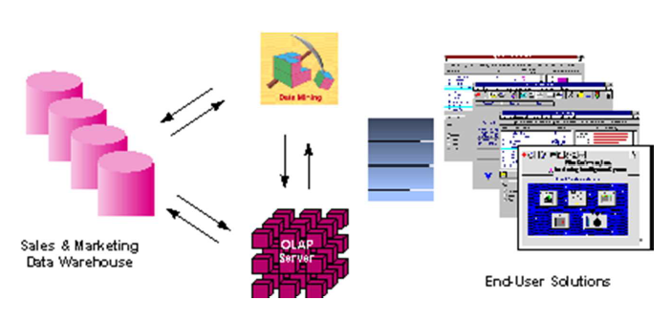
Data mining architecture

Slide 6
Data Pre-processing
Data pre-processing includes cleaning, normalization, transformation, feature extraction and selection, etc. The product of data preprocessing is the final training set.
Raw data is highly susceptible to noise, missing values, and inconsistency. The quality of data affects the data mining results. In order to help improve the quality of the data and, consequently, of the mining results raw data is preprocessed so as to improve the efficiency and ease of the mining process.
Data pre-processing methods are divided into following categories:
Data Cleaning
Data Integration
Data Transformation
Data Reduction

Slide 7
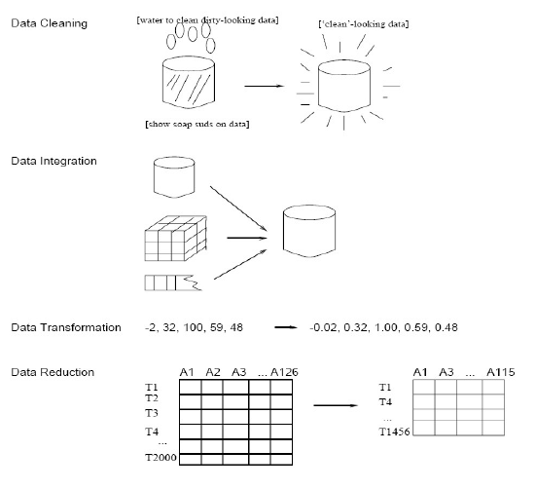

Slide 8
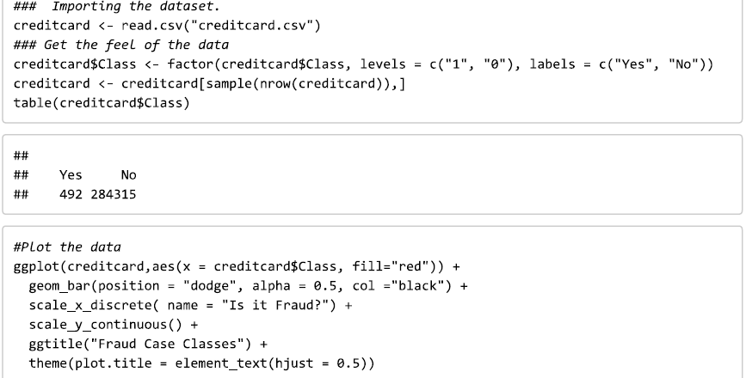

Slide 9
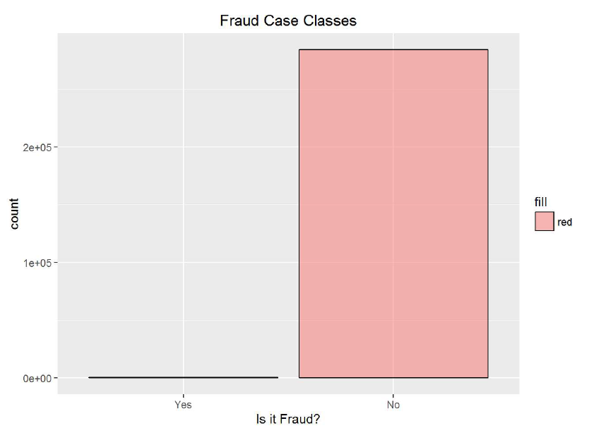

Slide 10
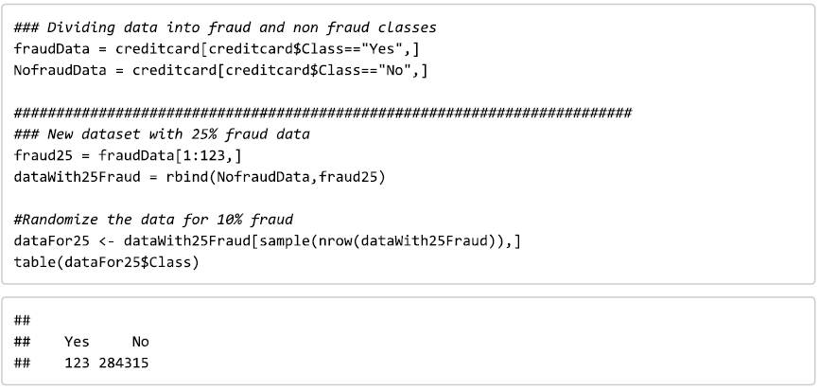

Slide 11
SMOTE
Unbalanced classification problems cause problems to many learning algorithms. These problems are characterized by the uneven proportion of cases that are available for each class of the problem.
SMOTE is a well-known algorithm to fight this problem.
This function handles unbalanced classification problems using the SMOTE method. Namely, it can generate a new "SMOTE" data set that addresses the class unbalance problem. Alternatively, it can also run a classification algorithm on this new data set and return the resulting model.
Usage
SMOTE(form, data, perc.over = 200, k = 5, perc.under = 200, learner = NULL, ...)

Slide 12
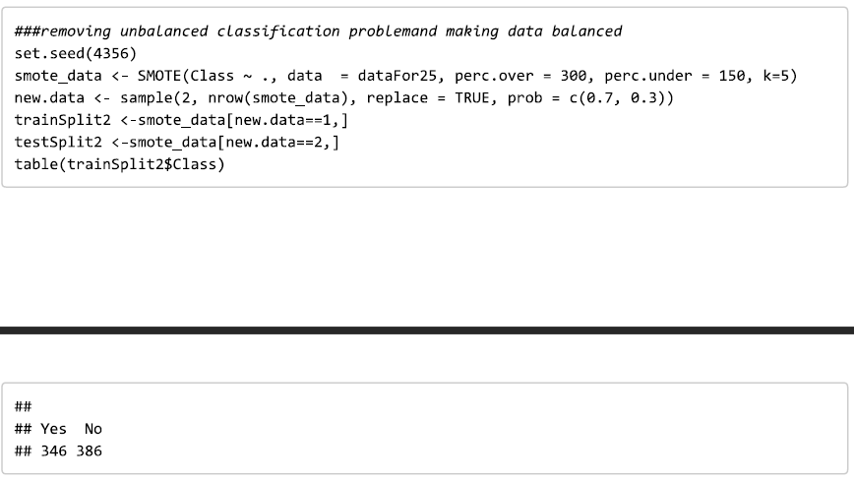

Slide 13
K – Nearest Neighbours
K Nearest Neighbors (KNN) is one of those algorithms that are very simple to understand but works incredibly well in practice.
It is surprisingly versatile and its applications range from vision to proteins to computational geometry to graphs and so on.
KNN is an non parametric lazy learning algorithm. That is a pretty concise statement.
The dichotomy is pretty obvious here – There is a non existent or minimal training phase but a costly testing phase. The cost is in terms of both time and memory.

Slide 14
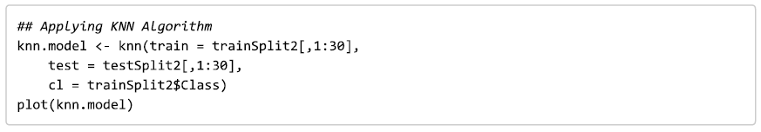
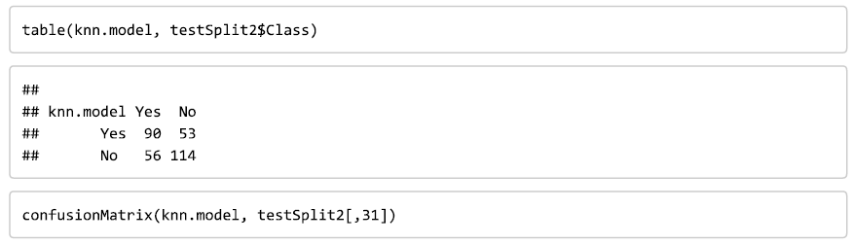

Slide 15
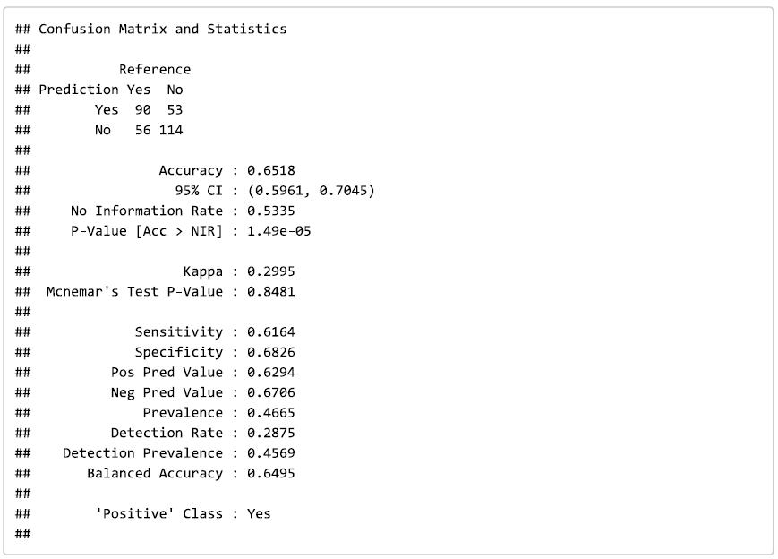

Slide 16
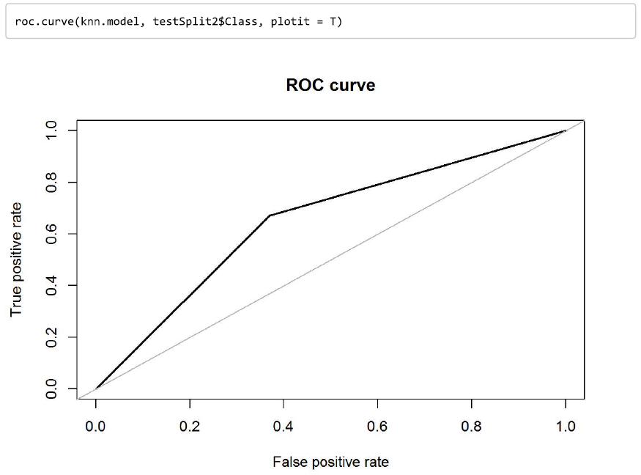

Slide 17
Support Vector Machine
“Support Vector Machine” (SVM) is a supervised machine learning algorithm which can be used for both classification or regression challenges.
It is mostly used in classification problems.
Support Vectors are simply the co-ordinates of individual observation. Support Vector Machine is a frontier which best segregates the two classes (hyper-plane/ line).

Slide 18
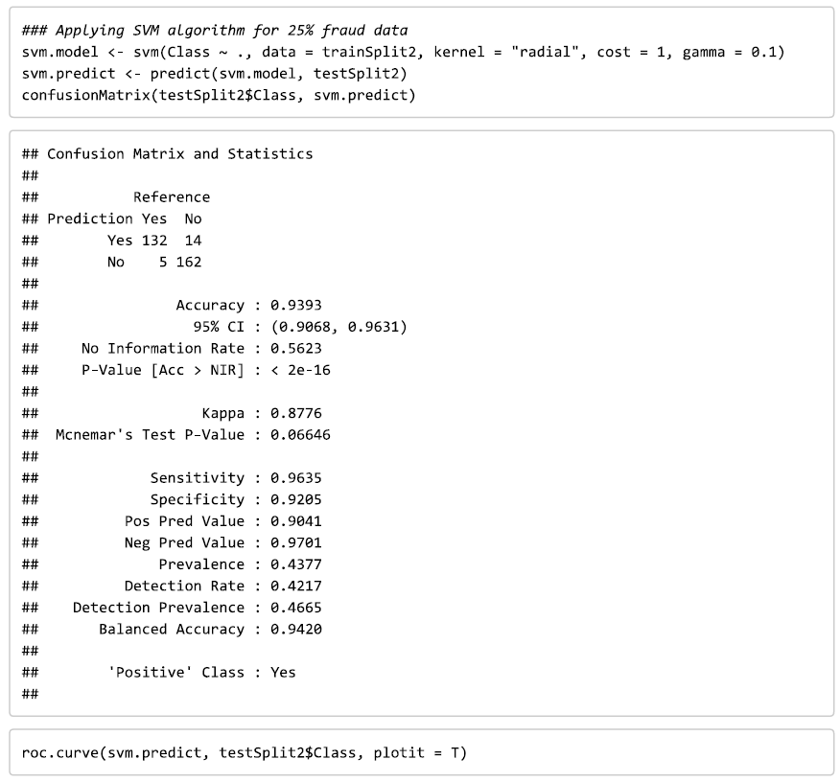

Slide 19
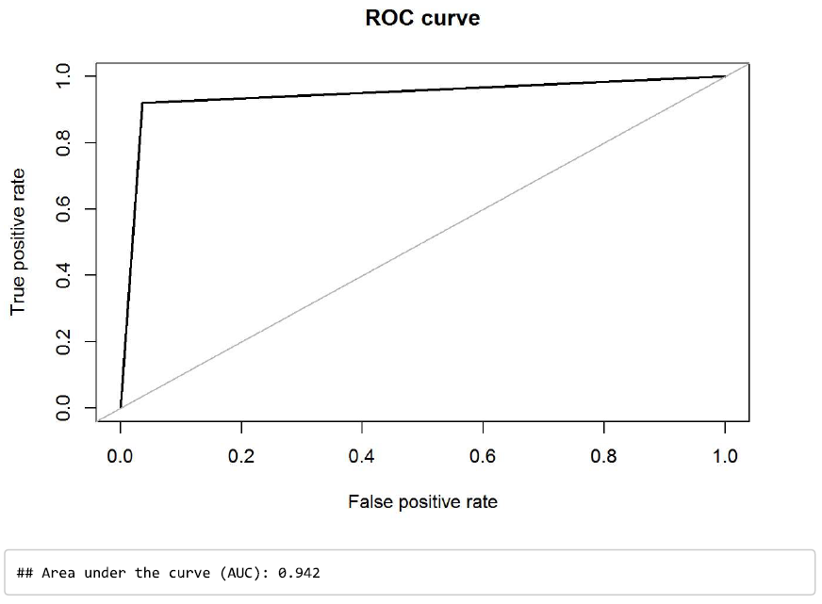

Slide 20
Random Forest
Random Forests grows many classification trees. To classify a new object from an input vector, put the input vector down each of the trees in the forest.
Each tree gives a classification, and we say the tree "votes" for that class. The forest chooses the classification having the most votes (over all the trees in the forest).
It is unexcelled in accuracy among current algorithms.
It runs efficiently on large data bases.
It can handle thousands of input variables without variable deletion.

Slide 21
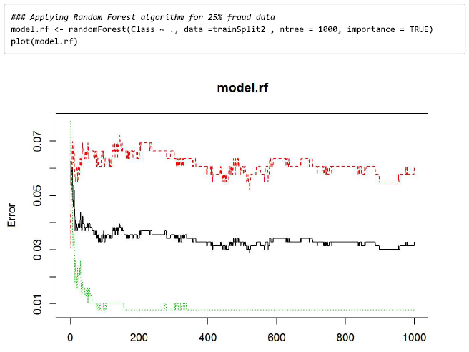

Slide 22
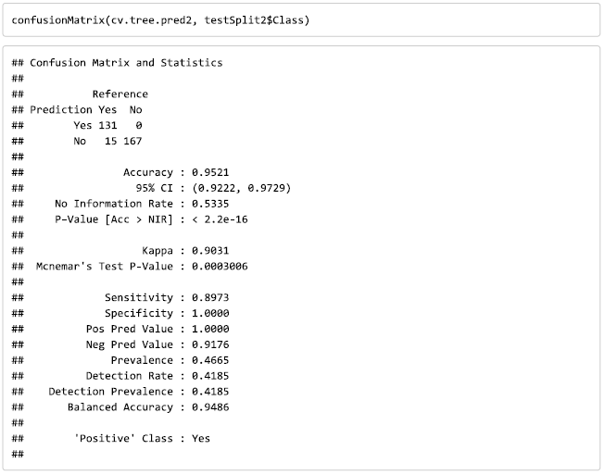

Slide 23
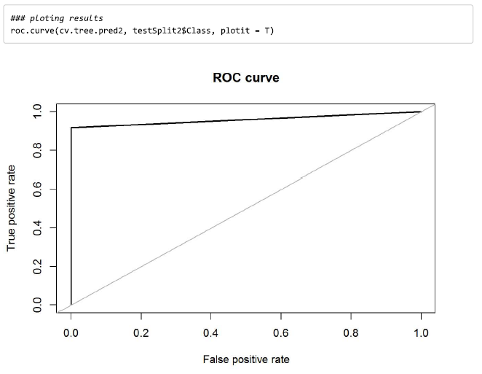

Slide 24
Logistic Regression
Logistic regression predicts the probability of an outcome that can only have two values (i.e. a dichotomy). The prediction is based on the use of one or several predictors (numerical and categorical).
A linear regression will predict values outside the acceptable range (e.g.
predicting probabilities outside the range 0 to 1) Since the dichotomous experiments can only have one of two possible values for each experiment, the residuals will not be normally distributed about thepredicted line.

Slide 25
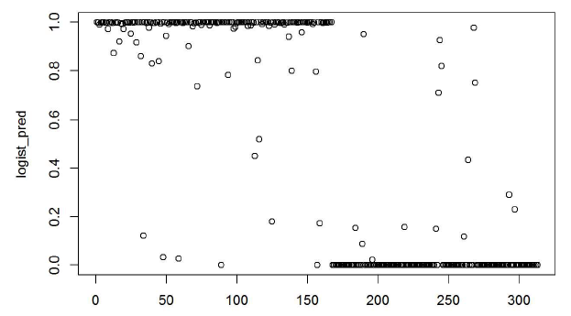

Slide 26


Slide 27
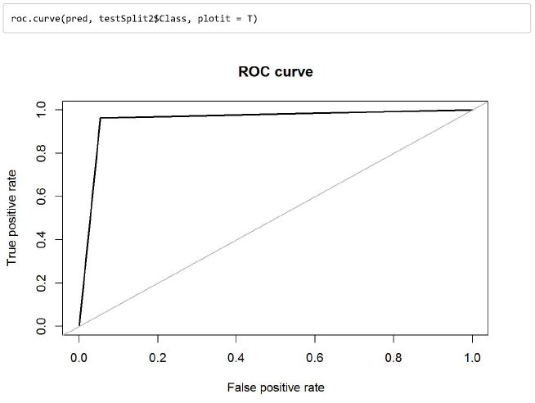

Slide 28
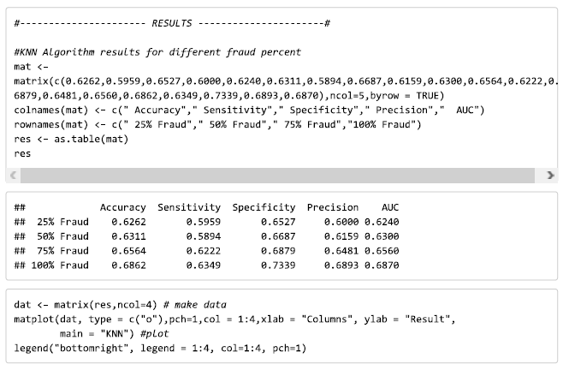
Results - knn

Slide 29
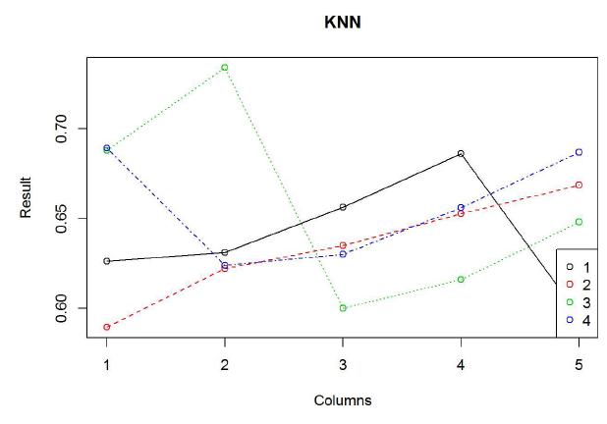

Slide 30
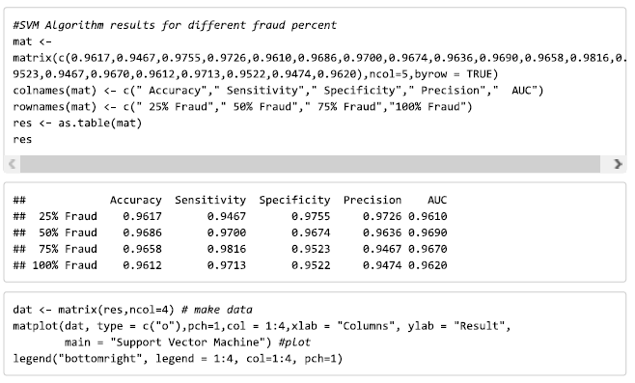
Results - SVM

Slide 31
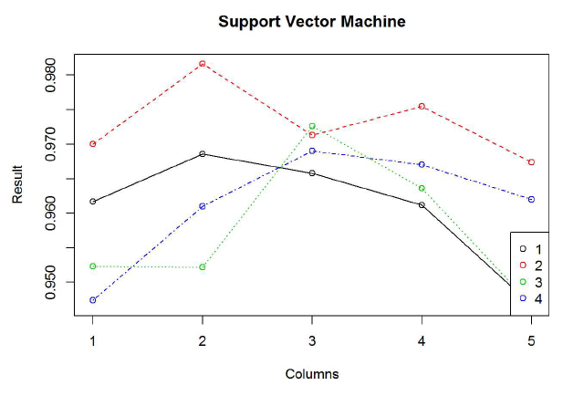

Slide 32
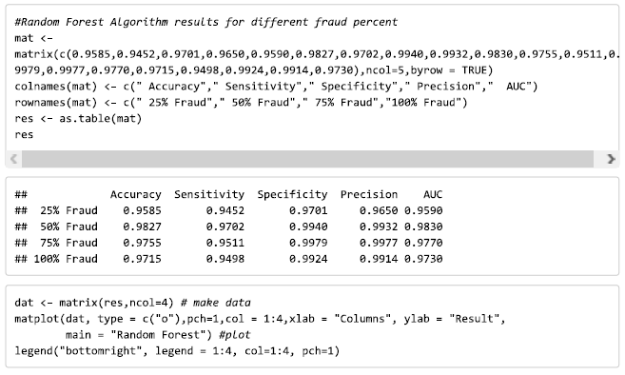
Results – random forest

Slide 33
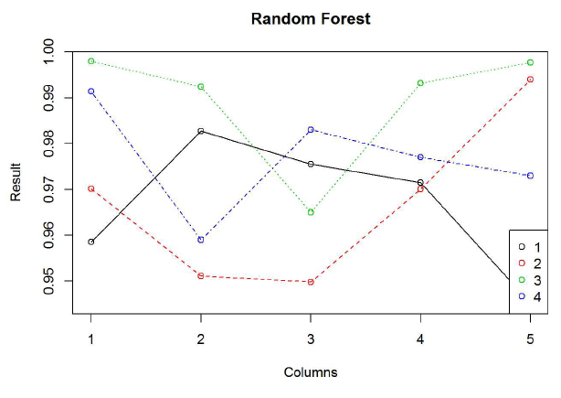

Slide 34
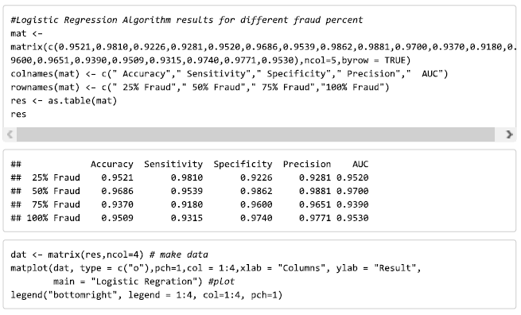
Results – logistic regression

Slide 35
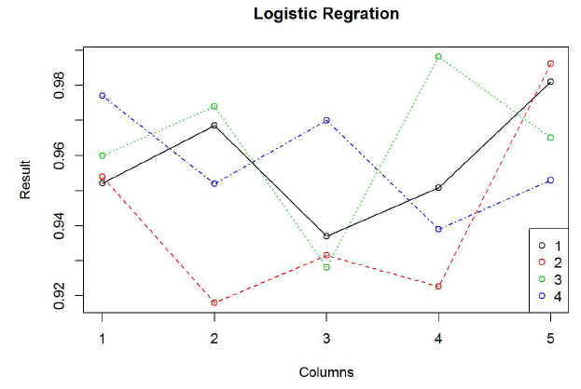

Slide 36
conclusion
Finally, as the results in table shows that highest accuracy in given by the Random forest algorithm when applied all algorithms with SMOTE data balancing technique. These results are formed on taking different fraud data rates in the dataset before applying to the algorithms.

Slide 37
Future scope
More Algorithms can be applied on the same dataset to get goodresults.
Combination of two or more algorithms of data mining are very helpful in determining the best results. This combination of algorithms is known as Hybrid Algorithm.
Also by making classifiers in present algorithms and applying new upcoming algorithms may be helpful for improvement.
Choosing only those attributes which most affect the liver if slight change in quantity occurs in body. And applying Different approaches may improve the outcomes.

Slide 38
references
Masoumeh Zareapoor, P.Shamsolmoali{2015}. Application of Credit Card Fraud Detection: Based on Bagging Ensemmble Classifier.International Conference on Intelligent Computing And Convergence(ICCC-2015).
S. Kotsiantis, D. Kanellopoulos, P. Pintelas (2006). Handling imbalanced datasets: A review. International Transactions on Computer Science and Engineering.
G.H. John, P. Langley (1995). Estimating continuous distributions in Bayesian classifiers. in: Proceedings of the 11th Conference on Uncertainty in Artificial Intelligence, (1995); 338 — 345.
R.J. Bolton, D.J. Hand (2001). Unsupervised profiling methods for fraud detection. In Conference on credit scoring and credit control, Edinburgh.
D. Kibler. D.W. Aha, M. Albeit (1989). Instance-based prediction of realvalued attributes. Computational Intelligent
P.K. Chan, W. Fan, A.L. Prodromidis. S.J. Stolfo ( 1999). Distributed Data Mining in Credit Card Fraud Detection. IEEE Intelligent Systems. pp 67—74.
C. Cortes, V. Vapnik (1995). Support vector networks. Machine Learning. 20:273—297.

